Slide 1

compartmental models used in epidemiology
Presentation by
AC (Akos) Steger
Methodology & Statistics Ling. Research LTR002M10.2019-2020.2

Slide 2

Background
Ongoing SARS – CoV – 2 outbreak
Global impact on an unparalleled scale
Missing information in terms of healthcare, political and societal implications
Fake news, political benefit-forging

Slide 3



Compartmental models
= simplified technique to mathematically model infectious disease dynamics
Finds parameters for infectious diseases based on assumptions
Two main types: deterministic and stochastic
Deterministic: same parameters always return same results
Stochastic: basic equations as probability distributions
Benefits for specialists:
・ Measure magnitude of epidemic
・ Can plan restrictions and relaxations
Benefits for laypeople:
・Increased understanding of policies
・Correct interpretation of news

Slide 4
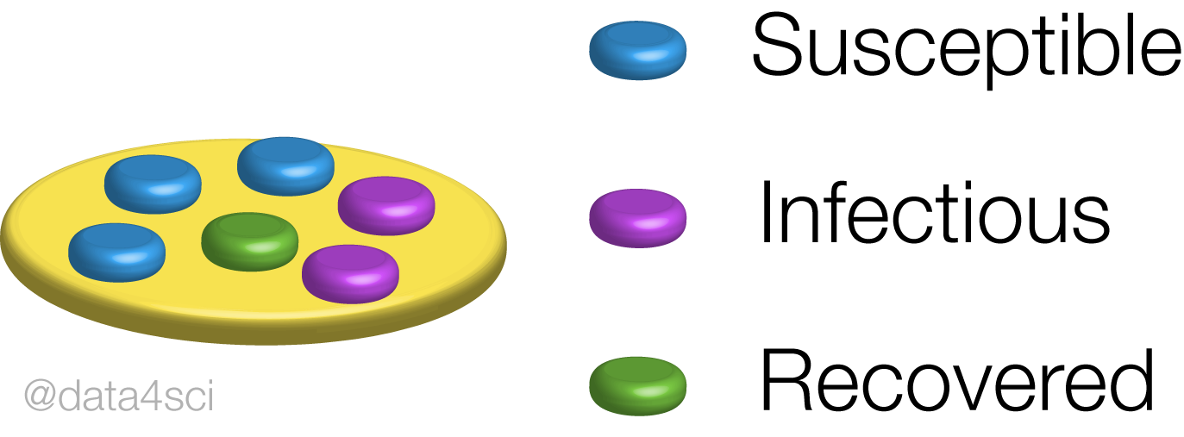
What do we mean by ‘compartments’?
Splits whole population into subgroups (‘compartments’)
Subgroups labelled according to basic property (e.g. S, I, R)
Every inhabitant assigned into one of groups
Progression between compartments ~ disease dynamics

Slide 5





POPULATION:
10
9

Slide 6

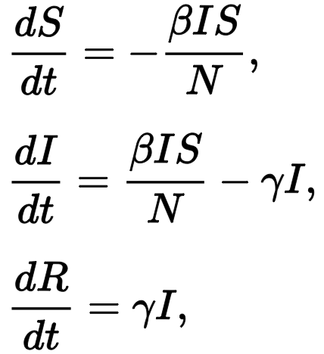
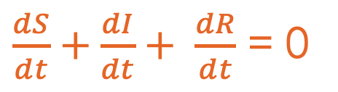
ModeLling of epidemiology:
Kermack-McKendrick Theory (1927)
Number & distribution of infections over time
Only infection and removal events
✔︎ Simple epidemic (incl. threshold condition for an outbreak)
✖️ Endemic / recurring disease
β: transmission rate
γ: removal rate
$\frac{dS}{dt}+\frac{dI}{dt}+ \frac{dR}{dt}$ = 0

Slide 7
Assumptions
No assumptions for: linearity, normality or homogeneity
00
Whole population belongs to a certain group
01
Rectangular and stationary age distribution
02

Slide 8
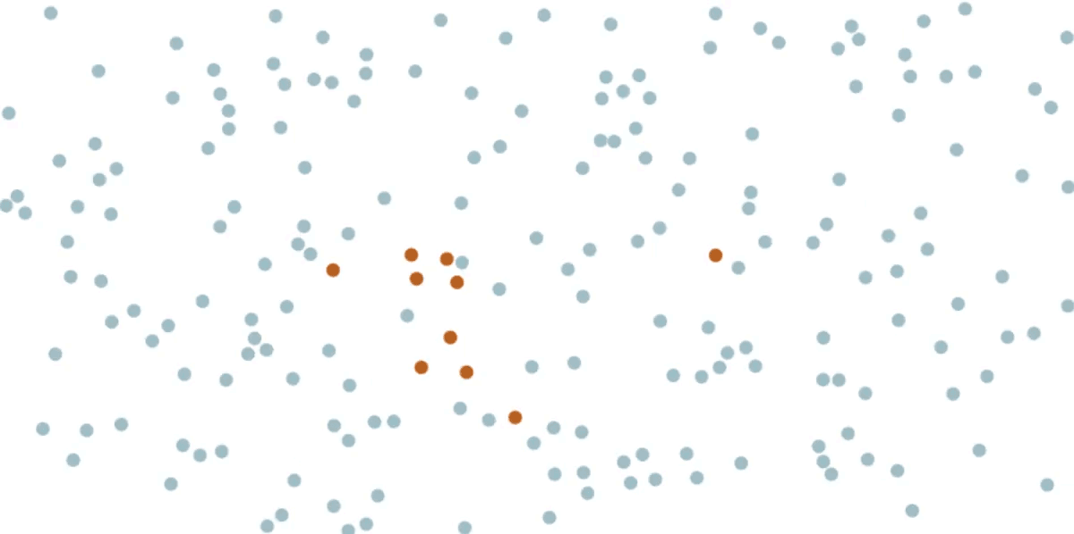
Assumptions
03
Homogeneous, well mixed population where disease spreads evenly
© Harry Stevens, The Washington Post

Slide 9
Types of compartmental models 1.
SIR (Susceptible – Infected - Recovered): Assumes lifelong immunity to the disease (most basic model), e.g. measles
SIS (Susceptible - Infected - Susceptible No immunity developed, e.g. common cold
SEIR (Susceptible – Exposed - Infected - Recovered) Non-infectious incubation period & lifelong immunity after recovery, e.g. chicken pox

Slide 10
Types of compartmental models 2.
SEIRS (Susceptible – Exposed - Infected – Recovered - Susceptible) Only temporal immunity, disease becomes an endemic, e.g. malaria
MSIR (Maternally derived immunity – Susceptible – Infectious - Recovered) Babies gain immunity thanks to the antibodies in the body of their mothers, e.g. measles
Etc.

Slide 11

The SIR model
β = transmission rate (contact * possibility)
γ = recovery rate ($\frac{1}{D}$ : determined by avg. duration D)
βSI = interaction (contact) between S and I
γI = spontaneous (non-interacting) transition from Infectious to Recovered at a fixed rate γ

Slide 12
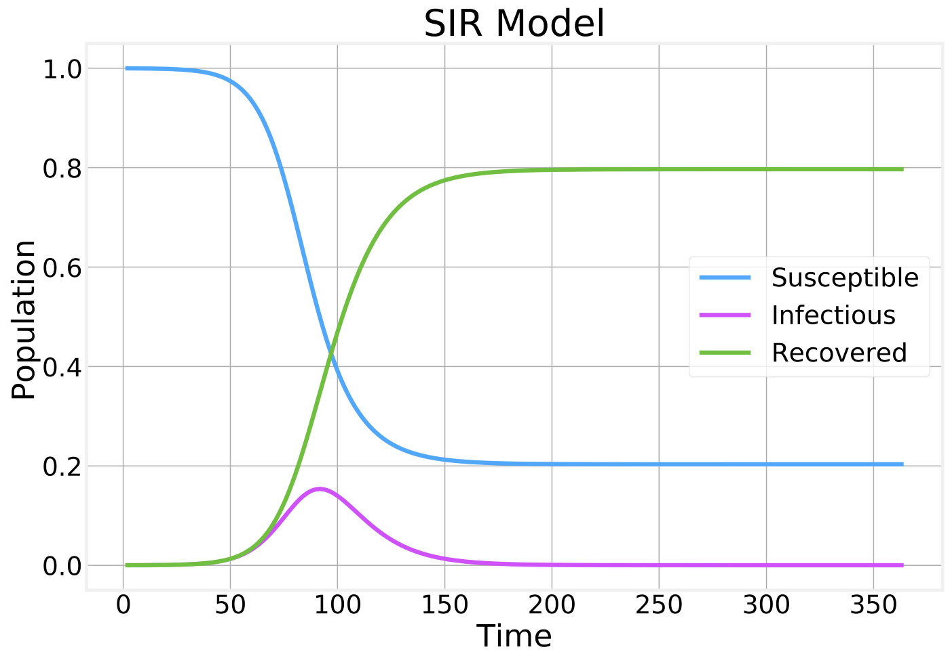
Visualization
Susceptibles: only decrease
Recovered: only increase
Number of infectious individuals peak and decline
Majority of the population becomes infected and then recovers

Slide 13
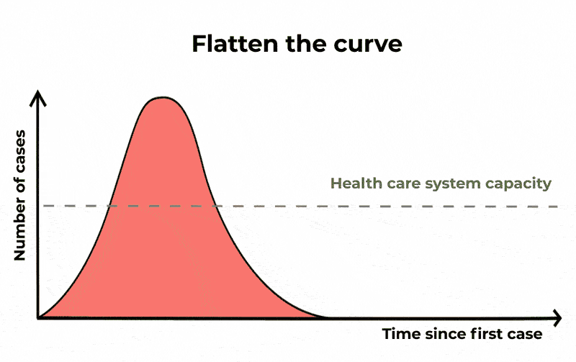

THE CURVE
$R_{0}$ = $\frac{β}{γ}$ = basic reproduction rate
Rₒ<1: disease stops
Rₒ>1: exponential growth
$S_{t}<\frac{N}{R_{0}}$ = herd immunity treshold
© The Conversation/CC BY ND

Slide 14
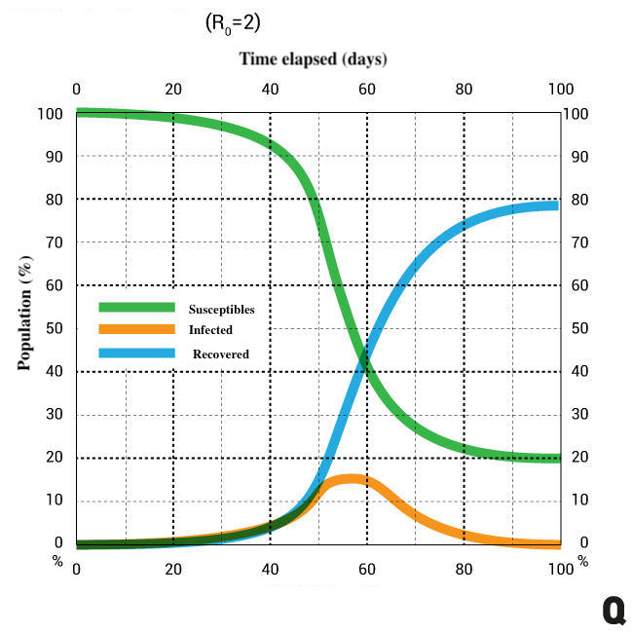
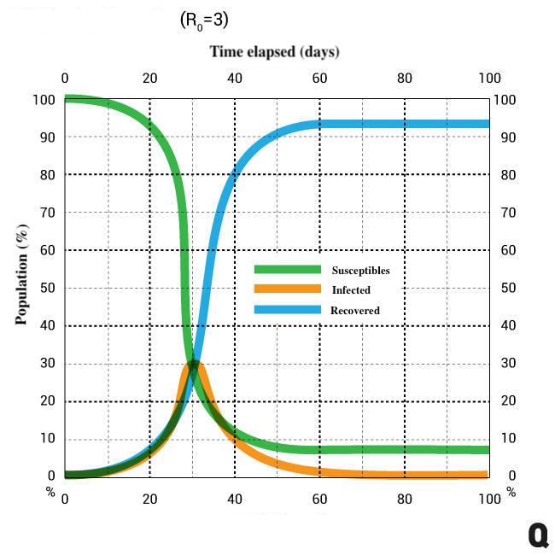

Effect of different $R_{0}$ values
Disease dynamics
in a SIR model
~80% infected
Disease dynamics
in a SIR model
90%+ infected, faster peak
Source: Qubit. - qubit.hu

Slide 15
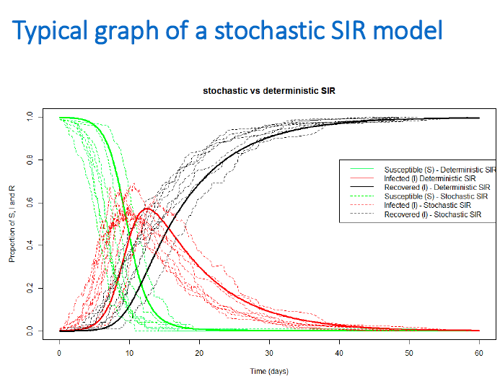
Stochastic models
Differential equations → Probability Distributions
Pseudo-stochastic: many independent deterministic models
Stochastic differential equations: adds stochastic terms
Event driven approaches →
© Andrea Doeschl Wilson

Slide 16

The building of a compartmentalised model
COVID-19 : novel pneumonia caused by a zoonotic virus
Outbreak: Wuhan, Hubei province, China (Dec 2019)
Origin #1: Natural selection in animal host before zoonotic transfer?
Origin #2: Natural selection in humans following zoonotic transfer?
© Pixabay.com

Slide 17
Is sir enough? Missing parameters?
Asymptomatic or mildly symptomatic spreaders?
Window period before positive test?
Recovery confers immunity?
Chance of mortality?

Slide 18
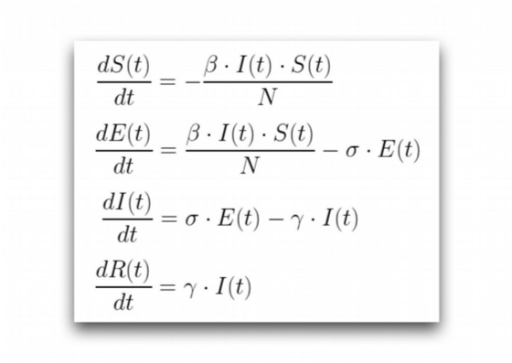

The SEIR model
✔︎ latent period ✖︎ mortality
For diseases with a significant incubation period: not yet infectious (compartment E)
σ: rate of latent to infectious (avg. duration of incubation: $\frac{1}{D}$ )
SEIR (Susceptible – Exposed - Infected - Recovered) Non-infectious incubation period & lifelong immunity after recovery, e.g. chicken pox

Slide 19
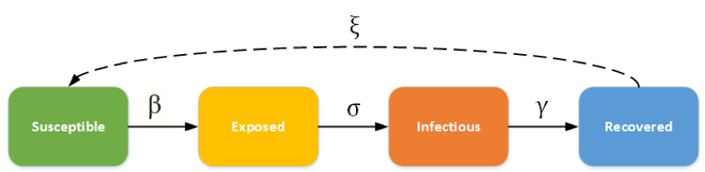
The SEIRS model
ξ: rate at which recovered lose immunity
✔︎ latent period ✖︎ immunity
・
SEIRS (Susceptible – Exposed - Infected – Recovered - Susceptible) Only temporal immunity, disease becomes an endemic, e.g. malaria

Slide 20
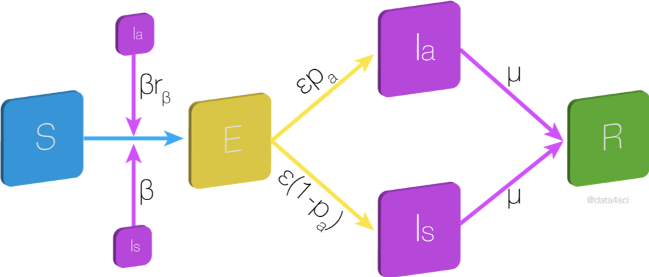
The SEIIR model
Asymptomatic: less infectious by fraction rᵦ.
pₐ becomes asymptomatic
1-pₐ develops symptoms
γ
SEIIR (Susceptible – Exposed – Infected [asymptomatic] – Infected - Recovered)
Covid-19: asymptomatic carriers ~ 40%
γ
Source: data4sci *

Slide 21
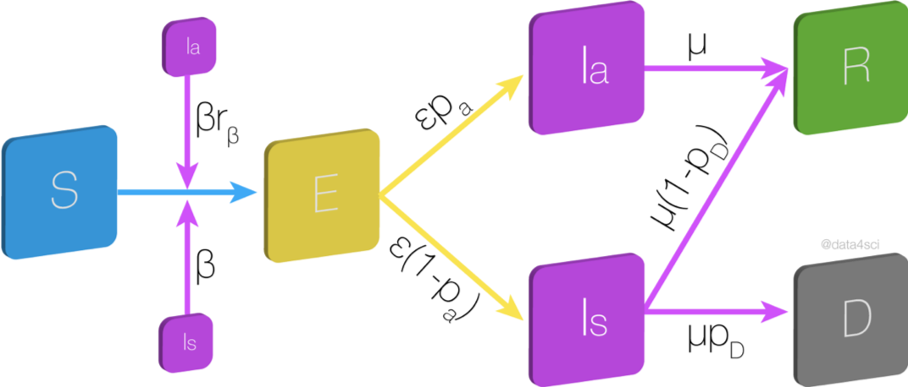
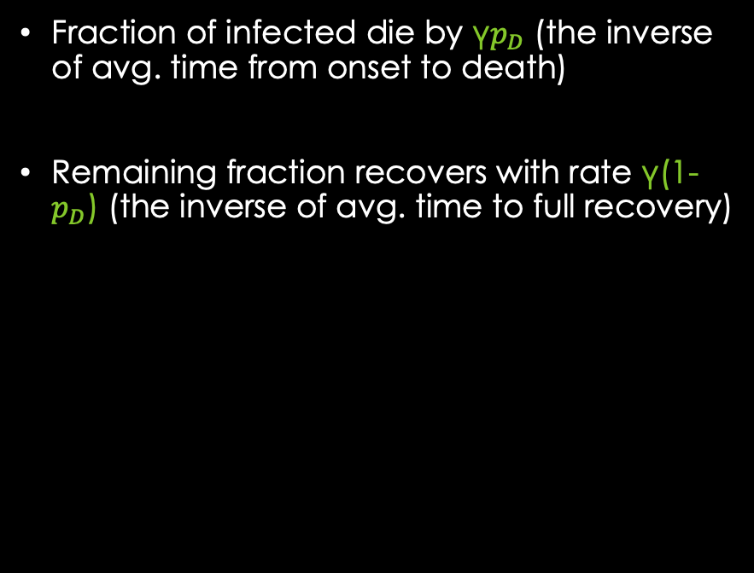
The SEIIRD model
Fraction of infected die by γ$p_{D}$ (the inverse of avg. time from onset to death)
Remaining fraction recovers with rate γ(1-$p_{D}$) (the inverse of avg. time to full recovery)
γ
γ
SEIIRD (Susceptible – Exposed – Infected [asymptomatic] – Infected – Recovered - Deceased)
γ
Source: data4sci *

Slide 22
Still more possible parameters
Confirmed vs. Real number of cases
Quarantine & social distancing
Vaccination etc...

Slide 23
Τηανκ you for your attention!

Slide 24
Resources
Allthiswasfield, Blogspot
http://allthiswasfield.blogspot.com/2020/04/another-flatten-covid-19-curve.html
Doeschl-Wilson, Andrea : Modelling Epidemics
https://jvanderw.une.edu.au/L7_ModellingEpidemics3.pdf
Goncalves, Bruno. Medium:
https://medium.com/data-for-science/epidemic-modeling-101-or-why-your-covid19-exponential-fits-are-wrong-97aa50c55f8
https://medium.com/data-for-science/epidemic-modeling-102-all-covid-19-models-are-wrong-but-some-are-useful-c81202cc6ee9
Idmod.org
https://idmod.org/docs/hiv/model-seir.html
Miller, Joel C. A note on the derivation of epidemic final sizes, Bull Math Biol. 2012 September ; 74(9): 2125–2141. doi:10.1007/s11538-012-9749-6.
Nesse, Hans - Global Health - SEIR Model
https://www.public.asu.edu/~hnesse/classes/seir.html?Beta=0.7878&Gamma=0.303&Sigma=0.196&Mu=0&Nu=0&initialS=9773000&initialE=4089&initialI=2000&initialR=0&iters=200
* image slightly modified by creator of slide

